Slide 1
Generalized Linear Precoder and Decoder Design for MIMO Channels Using the Weighted MMSE Criterion
Hemanth Sampath, member IEEE

Slide 2
Abstract
Overview:
Goal: Design optimum linear precoder and decoder for MIMO channels with possible delay spread.
Criterion: Weighted minimum mean-squared error (MMSE) under a transmit power constraint.
Key Results:
Channel Diagonalization:
Optimum precoder and decoder diagonalize the MIMO channel into eigen subchannels.
Works for any set of error weights.
Design Variations Based on Error Weights:
Maximum Information Rate (max-IR) Design
QoS-Based Design: Achieve specific SNR targets across subchannels.
Unweighted MMSE and Equal-Error Design: For fixed-rate systems.
Benefits:
Enhanced System Performance:
Specialized designs provide flexibility in maximizing information rate and meeting quality-of-service (QoS) requirements.

Slide 3
Contribution
Key contributions include:
System Models: Both single carrier and multicarrier systems operating on MIMO channels, with and without delay spread, demonstrating that they share the same form.
Optimum Structure: Optimum structure for the linear precoder and decoder, showing that they diagonalize the MIMO channel into eigen subchannels for any set of error weights.
Eigenmode transmission is optimum for these conditions.
Closed-Form Solutions: Closed-form solutions for the optimum precoder and decoder, which are functions of error weights, transmit power, receiver noise variance, and the eigenvalues of the MIMO channel.
Design Variations: We discuss how to select appropriate error weights to achieve:
Maximum Information Rate (max-IR) design
Quality of Service (QoS)-based design, allowing for the achievement of any set of relative SNRs across the subchannels
Optimum precoder and decoder designs for fixed-rate systems, specifically the unweighted MMSE and equal-error designs.

Slide 4
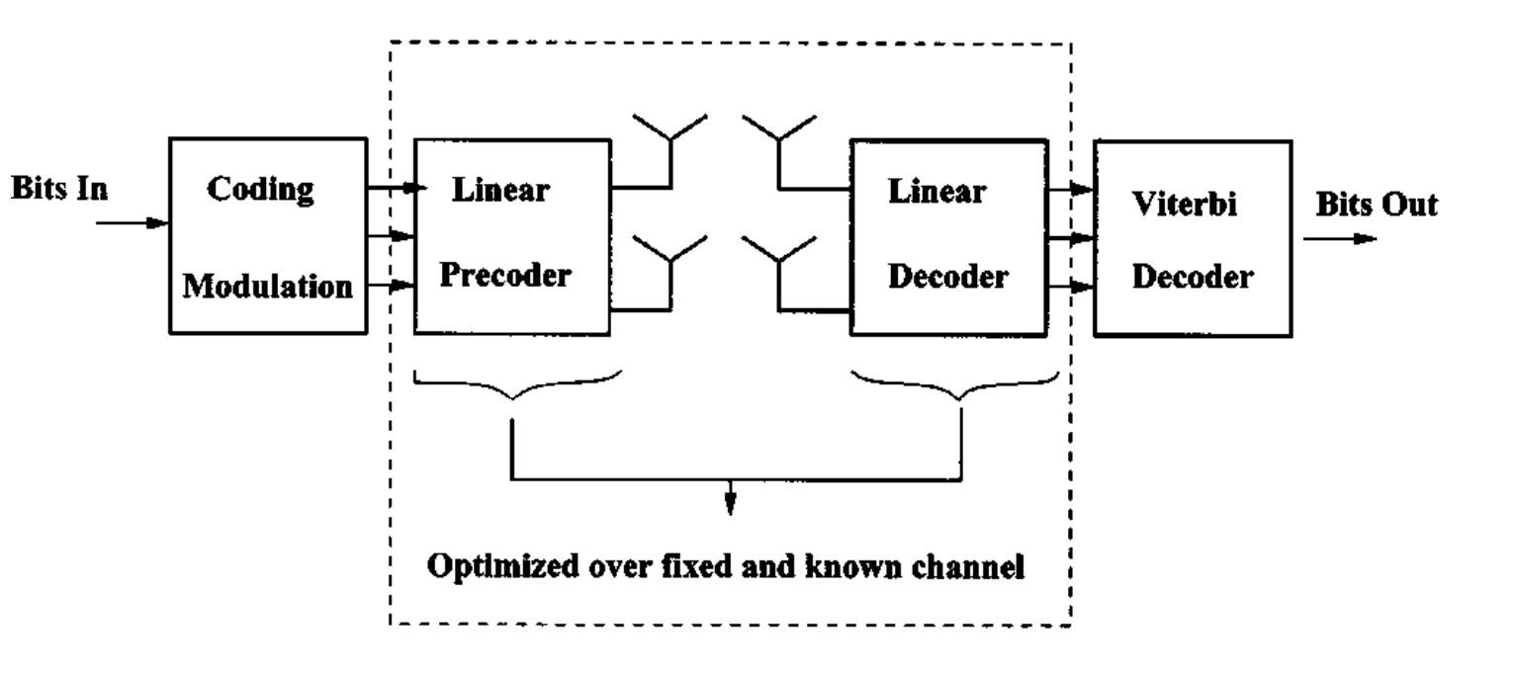
System Model
Fig 1. MIMO Communication System

Slide 5
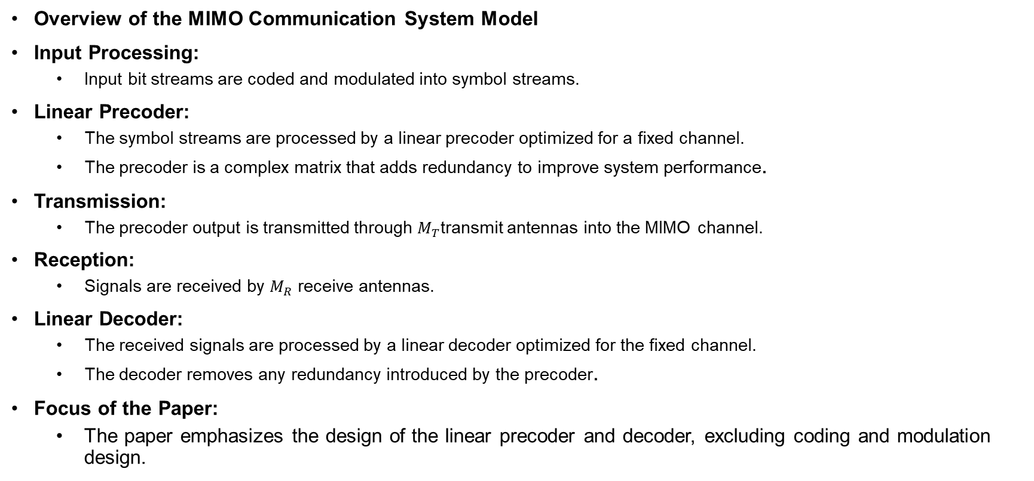
System Model
Overview of the MIMO Communication System Model
Input Processing:
Input bit streams are coded and modulated into symbol streams.
Linear Precoder:
The symbol streams are processed by a linear precoder optimized for a fixed channel.
The precoder is a complex matrix that adds redundancy to improve system performance.
Transmission:
The precoder output is transmitted through $M_{T}$transmit antennas into the MIMO channel.
Reception:
Signals are received by $M_{R}$ receive antennas.
Linear Decoder:
The received signals are processed by a linear decoder optimized for the fixed channel.
The decoder removes any redundancy introduced by the precoder.
Focus of the Paper:
The paper emphasizes the design of the linear precoder and decoder, excluding coding and modulation design.

Slide 6
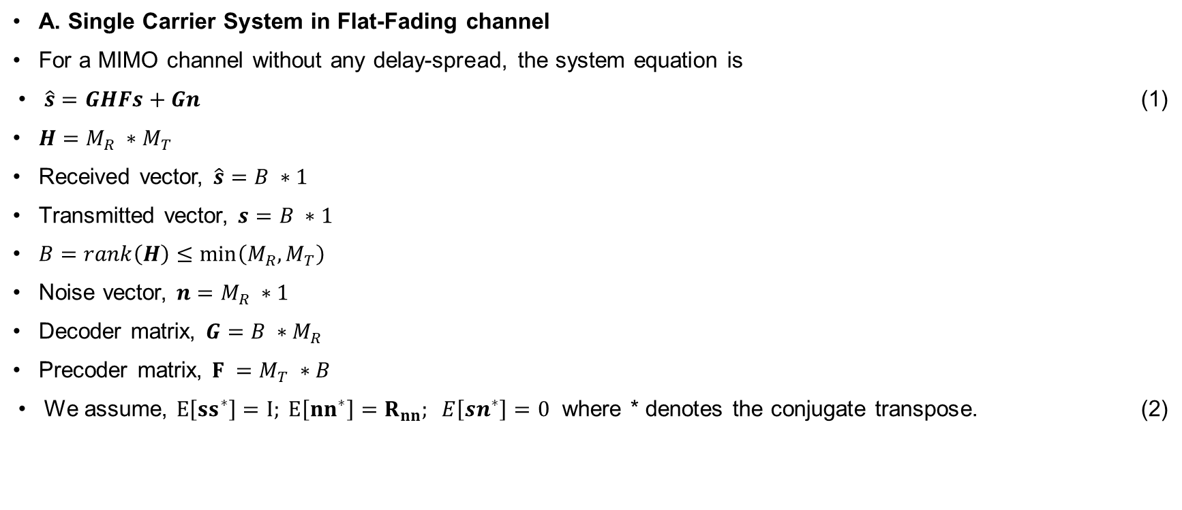
System Model
A. Single Carrier System in Flat-Fading channel
For a MIMO channel without any delay-spread, the system equation is
$\hat{s}=GHFs+Gn$ (1)
$H=M_{R} ∗M_{T}$
Received vector, $\hat{s}=B ∗1$
Transmitted vector, $s=B ∗1$
$B=rank\left(H\right)≤\min\left(M_{R},M_{T}\right)$
Noise vector, $n=M_{R} ∗1$
Decoder matrix, $G=B ∗M_{R}$
Precoder matrix, $F =M_{T} ∗B$
We assume, $E\left[{ss}^{∗}\right]=I; E\left[{nn}^{∗}\right]=R_{nn}; E\left[sn^{∗}\right]=0$ where * denotes the conjugate transpose. (2)

Slide 7
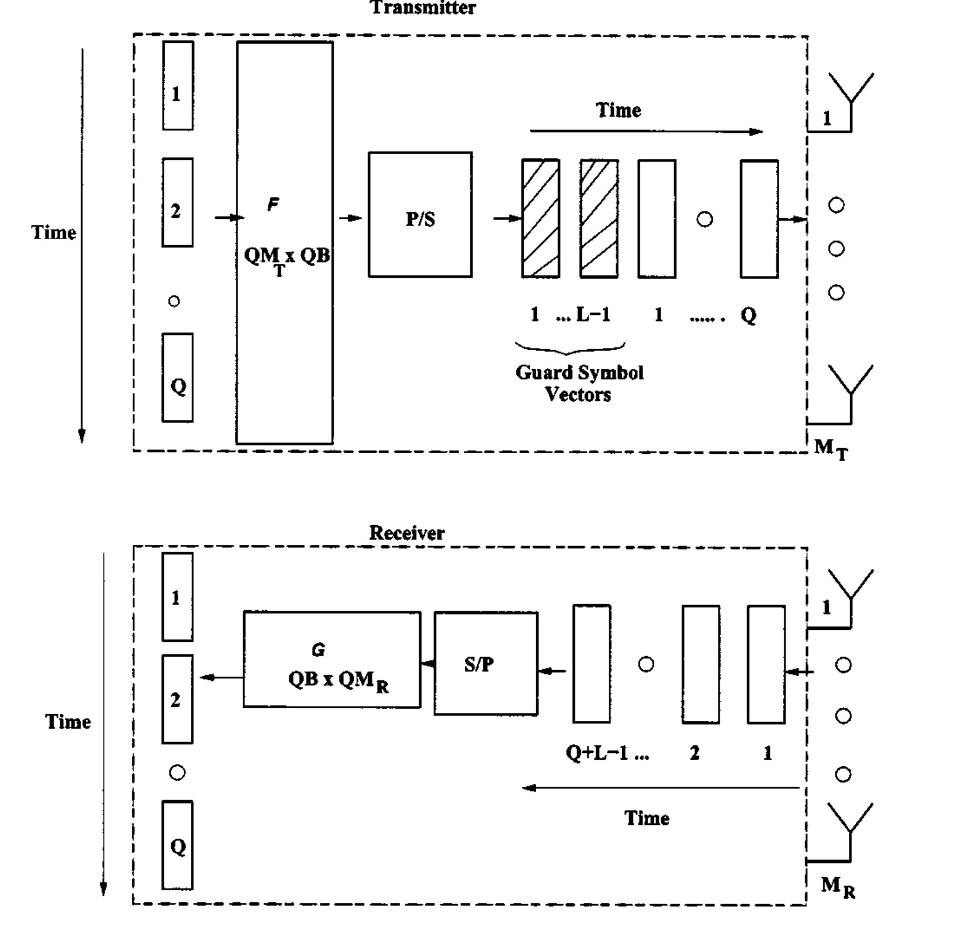
System Model
Fig. 2. Linear block precoding and decoding for delay-spread channels

Slide 8
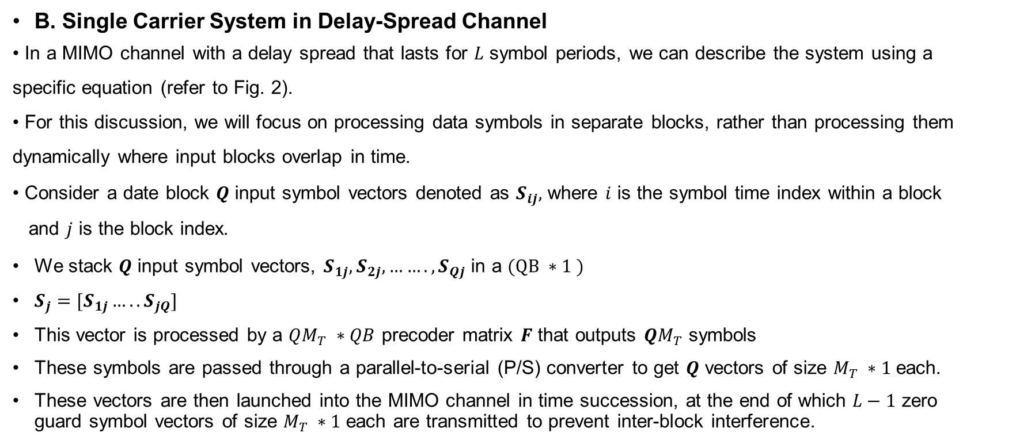
System Model
B. Single Carrier System in Delay-Spread Channel
In a MIMO channel with a delay spread that lasts for $L$ symbol periods, we can describe the system using a specific equation (refer to Fig. 2).
For this discussion, we will focus on processing data symbols in separate blocks, rather than processing them dynamically where input blocks overlap in time.
Consider a date block $Q$ input symbol vectors denoted as $S_{ij},$ where $i$ is the symbol time index within a block
and $j$ is the block index.
We stack $Q$ input symbol vectors, $S_{1j}, S_{2j},……., S_{Qj}$ in a $(QB ∗1 )$
$S_{j}=[S_{1j}….. S_{jQ}]$
This vector is processed by a $QM_{T} ∗QB$ precoder matrix $F$ that outputs $QM_{T}$ symbols
These symbols are passed through a parallel-to-serial (P/S) converter to get $Q$ vectors of size $M_{T} ∗1$each.
These vectors are then launched into the MIMO channel in time succession, at the end of which $L−1$ zero guard symbol vectors of size $M_{T} ∗1$each are transmitted to prevent inter-block interference.

Slide 9
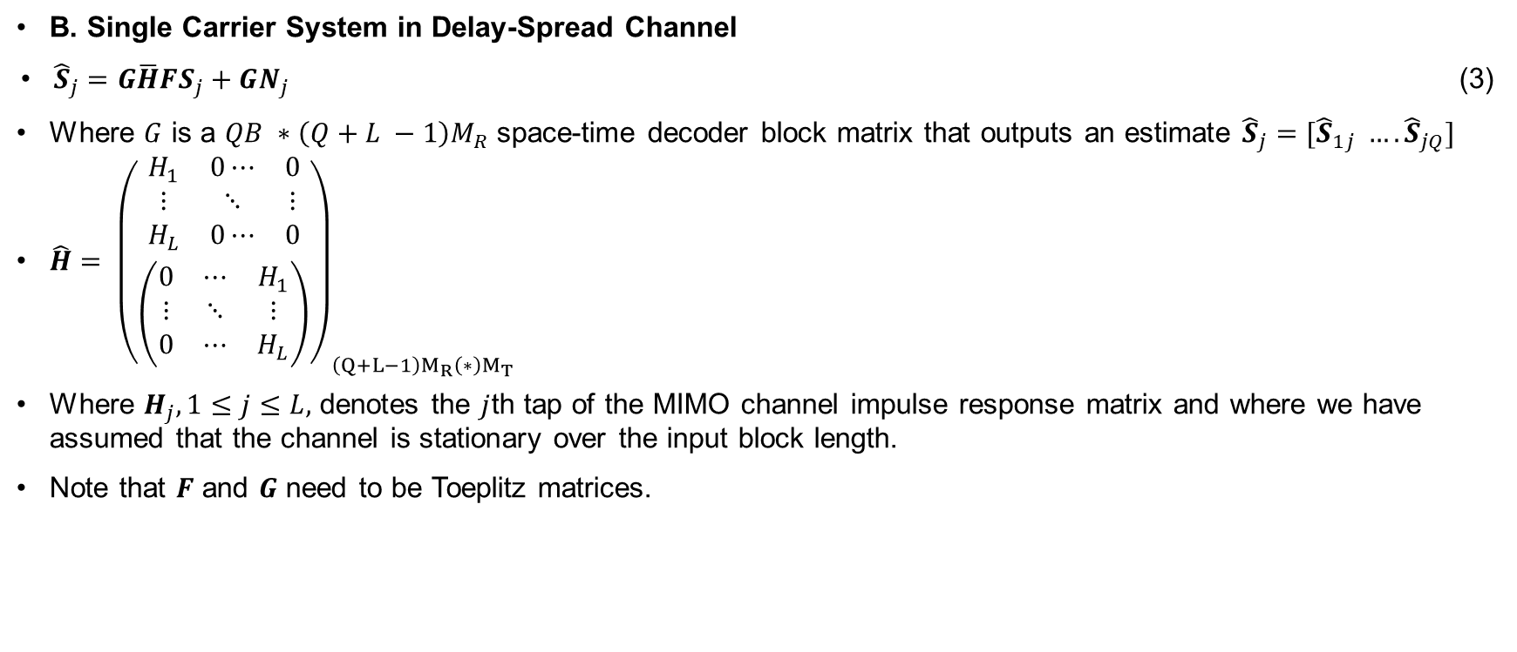
System Model
B. Single Carrier System in Delay-Spread Channel
${\hat{S}}_{j}=G\overline{H}FS_{j}+GN_{j}$ (3)
Where $G$ is a $QB ∗\left(Q+L −1\right)M_{R}$ space-time decoder block matrix that outputs an estimate ${\hat{S}}_{j}=[{\hat{S}}_{1j} …. {\hat{S}}_{jQ}]$
$\hat{H}= {\left(\begin{aligned}\begin{matrix}H_{1} & 0⋯ & 0 \\ ⋮ & ⋱ & ⋮ \\ H_{L} & 0⋯ & 0\end{matrix} \\ \left(\begin{matrix}0 & ⋯ & H_{1} \\ ⋮ & ⋱ & ⋮ \\ 0 & ⋯ & H_{L}\end{matrix}\right)\end{aligned}\right)}_{\left(Q+L−1\right)M_{R}\left(∗\right)M_{T}}$
Where $H_{j}, 1≤j≤L,$ denotes the $j$th tap of the MIMO channel impulse response matrix and where we have assumed that the channel is stationary over the input block length.
Note that $F$ and $G$ need to be Toeplitz matrices.

Slide 10
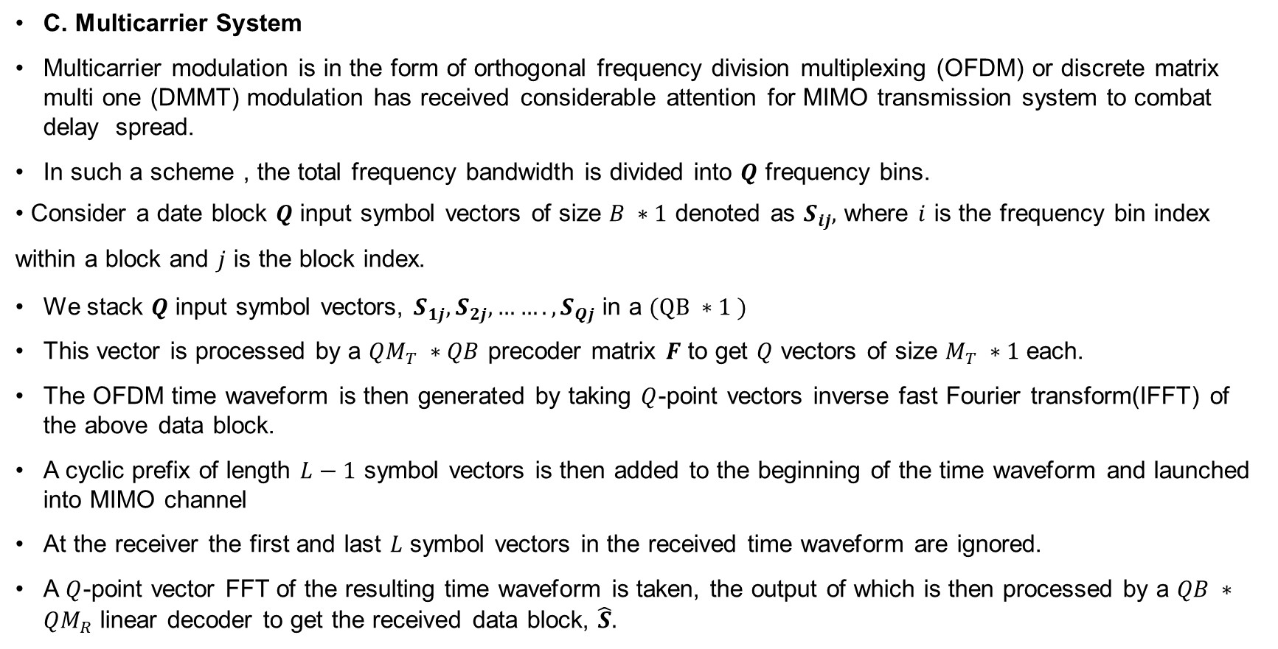
System Model
C. Multicarrier System
Multicarrier modulation is in the form of orthogonal frequency division multiplexing (OFDM) or discrete matrix multi one (DMMT) modulation has received considerable attention for MIMO transmission system to combat delay spread.
In such a scheme , the total frequency bandwidth is divided into $Q$ frequency bins.
Consider a date block $Q$ input symbol vectors of size $B ∗1$ denoted as $S_{ij},$ where $i$ is the frequency bin index within a block and $j$ is the block index.
We stack $Q$ input symbol vectors, $S_{1j}, S_{2j},……., S_{Qj}$ in a $(QB ∗1 )$
This vector is processed by a $QM_{T} ∗QB$ precoder matrix $F$ to get $Q$ vectors of size $M_{T} ∗1$ each.
The OFDM time waveform is then generated by taking $Q$-point vectors inverse fast Fourier transform(IFFT) of the above data block.
A cyclic prefix of length $L−1$ symbol vectors is then added to the beginning of the time waveform and launched into MIMO channel
At the receiver the first and last $L$ symbol vectors in the received time waveform are ignored.
A $Q$-point vector FFT of the resulting time waveform is taken, the output of which is then processed by a $QB ∗QM_{R}$ linear decoder to get the received data block, $\hat{S}.$

Slide 11
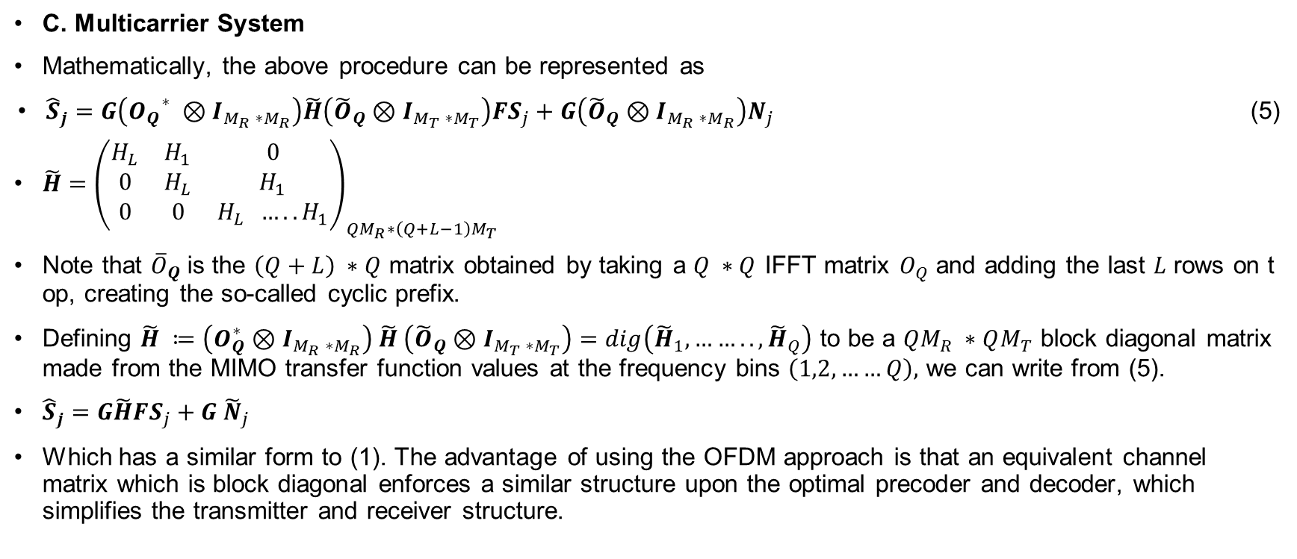
System Model
C. Multicarrier System
Mathematically, the above procedure can be represented as
${\hat{S}}_{j}=G\left({O_{Q}}^{∗} ⊗I_{M_{R} ∗M_{R}}\right)\tilde{H}\left({\tilde{O}}_{Q}⊗I_{M_{T} ∗M_{T}}\right)FS_{j}+G\left({\tilde{O}}_{Q}⊗I_{M_{R} ∗M_{R}}\right)N_{j}$ (5)
$\tilde{H}={\left(\begin{matrix}H_{L} & H_{1} & 0 \\ 0 & H_{L} & H_{1} \\ 0 & 0 & H_{L} …..H_{1}\end{matrix}\right)}_{QM_{R}∗\left(Q+L−1\right)M_{T}}$
Note that ${\overline{O}}_{Q}$ is the $\left(Q+L\right) ∗Q$ matrix obtained by taking a $Q ∗Q$ IFFT matrix $O_{Q}$ and adding the last $L$ rows on top, creating the so-called cyclic prefix.
Defining $\tilde{H} ≔\left(O_{Q}^{∗}⊗I_{M_{R} ∗M_{R}}\right) \tilde{H} \left({\tilde{O}}_{Q}⊗I_{M_{T} ∗M_{T}}\right)=dig\left({\tilde{H}}_{1},…….., {\tilde{H}}_{Q}\right)$ to be a $QM_{R} ∗QM_{T}$ block diagonal matrix made from the MIMO transfer function values at the frequency bins $\left(1,2,……Q\right),$ we can write from (5).
${\hat{S}}_{j}=G\tilde{H}FS_{j}+G {\tilde{N}}_{j}$
Which has a similar form to (1). The advantage of using the OFDM approach is that an equivalent channel matrix which is block diagonal enforces a similar structure upon the optimal precoder and decoder, which simplifies the transmitter and receiver structure.

Slide 12
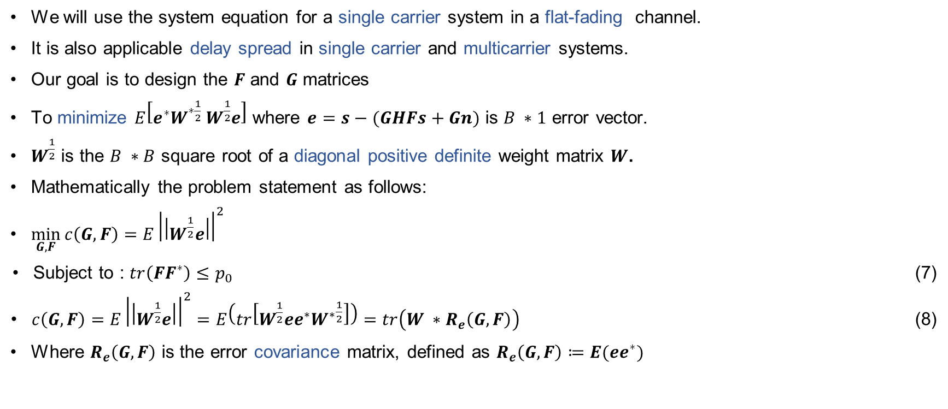
Problem Formulation
We will use the system equation for a single carrier system in a flat-fading channel.
It is also applicable delay spread in single carrier and multicarrier systems.
Our goal is to design the $F$ and $G$ matrices
To minimize $E\left[e^{∗}W^{∗\frac{1}{2}} W^{\frac{1}{2}}e\right]$ where $e=s−(GHFs+Gn)$ is $B ∗1$ error vector.
$W^{\frac{1}{2}}$ is the $B ∗B$ square root of a diagonal positive definite weight matrix $W$.
Mathematically the problem statement as follows:
$\min_{G,F}{c\left(G,F\right)=E{\left|\left|W^{\frac{1}{2}}e\right|\right|}^{2}}$
Subject to : $tr\left(FF^{∗}\right)≤p_{0}$ (7)
$c\left(G,F\right)=E{\left|\left|W^{\frac{1}{2}}e\right|\right|}^{2}=E\left(tr\left[W^{\frac{1}{2}}ee^{∗}{W^{∗}}^{\frac{1}{2}}\right]\right)=tr\left(W ∗R_{e}\left(G,F\right)\right)$ (8)
Where $R_{e}\left(G,F\right)$ is the error covariance matrix, defined as $R_{e}\left(G,F\right)≔E(ee^{∗})$

Slide 13
Problem Formulation
$R_{e}\left(G,F\right)=\left(GHF−I\right){\left(GHF−I\right)}^{∗}+GR_{nn}G^{∗}$ (9)
$L\left(μ,G,F\right)=c\left(G,F\right)+μ[tr\left(FF^{∗}\right) −p_{0}]$ (10)
Using (8) and (9) in (10), we can write
$L\left(μ,G,F\right)=tr\left[W\left(GHF−I\right){\left(GHF−I\right)}^{∗}+WGR_{nn}G^{∗}\right]+μ [tr\left(FF^{∗}\right)−p_{0}]$ (11)
The following KKT conditions are necessary and sufficient for optimally: $G$ and $F$ are optimal if and only if there is a $μ$ that together with $G$ and $F$ satisfy the conditions
$∇_{G}L\left(μ,G,F\right)=0$ (12)
$∇_{F}L\left(μ,G,F\right)=0$ (13)
$μ≥0; tr\left(FF^{∗}\right)−p_{0}≤0$ (14)
$μ\left[tr\left(FF^{∗}\right) −p_{0}\right]=0$ (15)
Using (11) in (12) and (13), we get the following relations between $G$ and $F$, respectively:
$HF=HFF^{∗}H^{∗}G^{∗}+R_{nn}G^{∗}$ (16)
$WGH=F^{∗}H^{∗}G^{∗}WGH+μG^{∗}$ (17)
To obtain (16) and (17), we have used the fact that $\frac{∂\left(tr\left(AXB\right)\right)}{∂X}=BA$ and $\frac{∂\left(tr\left(AX^{∗}B\right)\right)}{∂X}=0$

Slide 14
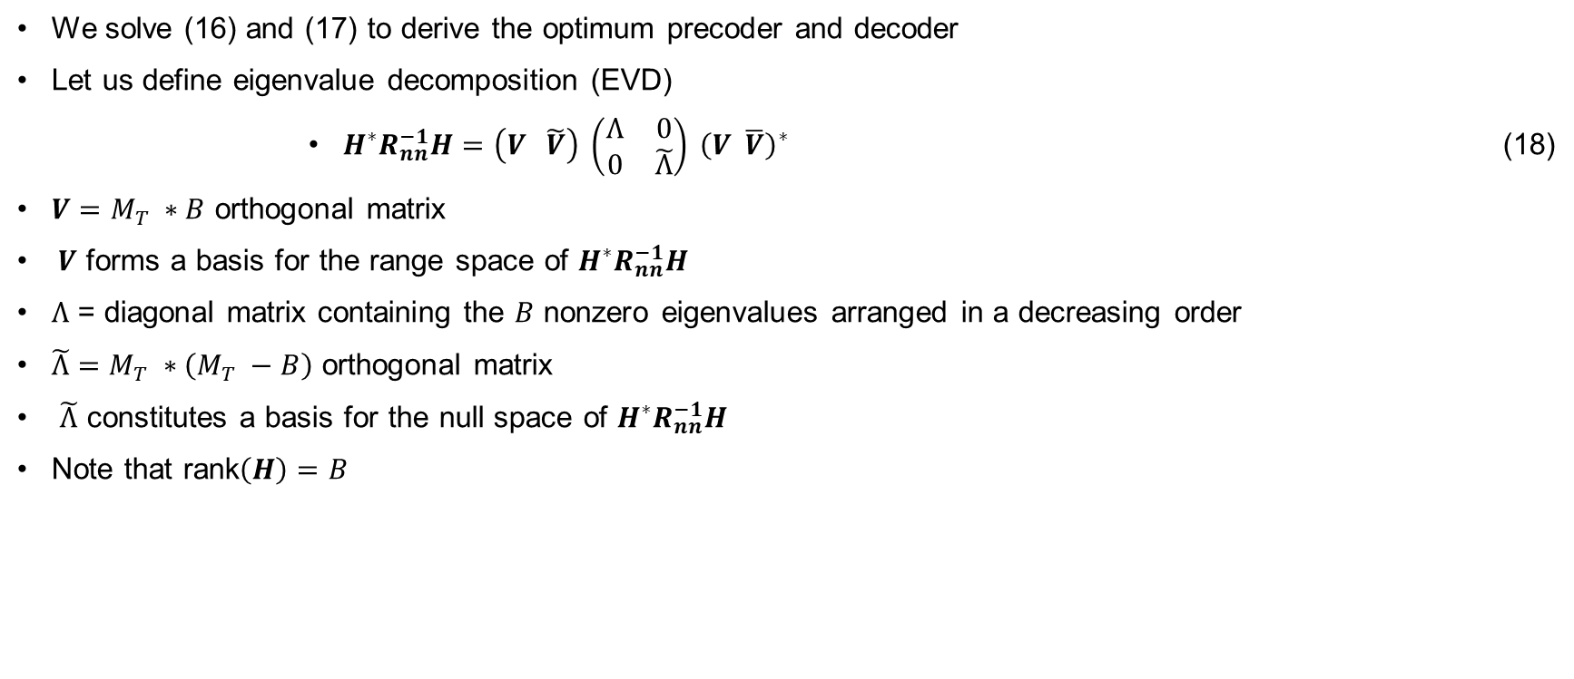
Optimum Precoder and Decoder
We solve (16) and (17) to derive the optimum precoder and decoder
Let us define eigenvalue decomposition (EVD)
$H^{∗}R_{nn}^{−1}H=\left(V \tilde{V}\right) \left(\begin{matrix}Ʌ & 0 \\ 0 & \tilde{Ʌ}\end{matrix}\right) {\left(V \overline{V}\right)}^{∗}$ (18)
$V=M_{T} ∗B$ orthogonal matrix
$V$ forms a basis for the range space of $H^{∗}R_{nn}^{−1}H$
$Ʌ$ = diagonal matrix containing the $B$ nonzero eigenvalues arranged in a decreasing order
$\tilde{Ʌ}=M_{T} ∗\left(M_{T} −B\right)$ orthogonal matrix
$\tilde{Ʌ}$ constitutes a basis for the null space of $H^{∗}R_{nn}^{−1}H$
Note that rank$\left(H\right)=B$

Slide 15

Optimum Precoder and Decoder
Lemma 1: The optimum $F$ and $G$ matrices can be assumed to have the following structure without any loss of generality
$F=V φ_{f}$ (19)
$G=φ_{g}V^{∗}H^{∗}R_{nn}^{−1}$ (20)
$φ_{f}$ and $φ_{g}$ are $B ∗B$ matrices .
A. Proof of Lemma 1
Consider $F$ and $G=\overline{G}R_{nn}^{−\frac{1}{2}}$
$F=Vφ_{f}+\tilde{V}{\tilde{φ}}_{f}=F_{||}+F̝$ (39)
$\overline{G}=φ_{g} V^{∗} H^{∗} R_{nn}^{−1/2}+{\tilde{φ}}_{g}{\tilde{V}}^{∗}$
$H^{∗} R_{nn}^{−1/2}=G_{||}+G̝̝$ (40)

Slide 16
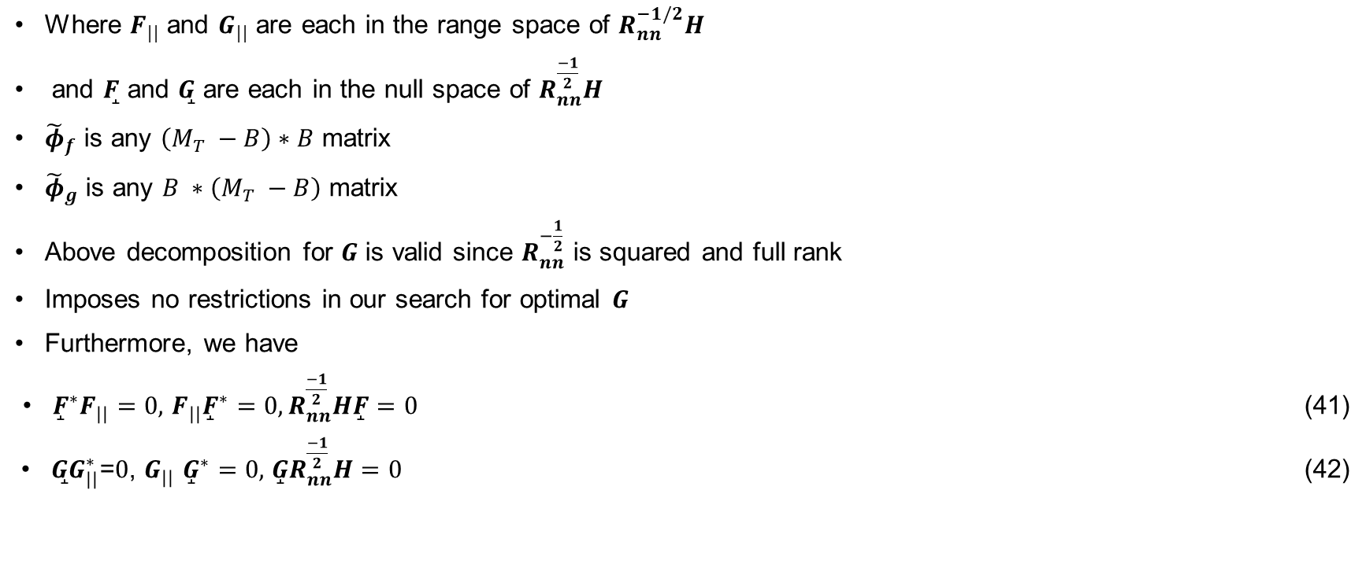
Optimum Precoder and Decoder
Where $F_{||}$ and $G_{||}$ are each in the range space of $R_{nn}^{−1/2}H$
and $F̝$ and $G̝̝$ are each in the null space of $R_{nn}^{\frac{−1}{2}}H$
${\tilde{φ}}_{f}$ is any $\left(M_{T} −B\right)∗B$ matrix
${\tilde{φ}}_{g}$ is any $B ∗\left(M_{T} −B\right)$ matrix
Above decomposition for $G$ is valid since $R_{nn}^{−\frac{1}{2}}$ is squared and full rank
Imposes no restrictions in our search for optimal $G$
Furthermore, we have
${\overset{̝}{F}}^{∗}F_{||}=0,$ $F_{||}{\overset{̝}{F}}^{∗}=0, R_{nn}^{\frac{−1}{2}}H\overset{̝}{F}=0$ (41)
$G̝̝G_{||}^{∗}$=$0$, $G_{||}$ ${\overset{̝}{G}}^{∗}=0,$ $\overset{̝}{G}R_{nn}^{\frac{−1}{2}}H=0$ (42)

Slide 17
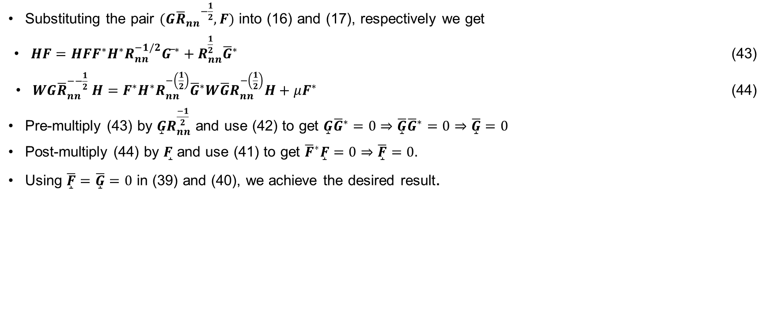
Optimum Precoder and Decoder
Substituting the pair $(G{{\overline{R}}_{nn}}^{−\frac{1}{2}}, F)$ into (16) and (17), respectively we get
$HF=HFF^{∗}H^{∗}R_{nn}^{−1/2}{G ̅}^{∗}+R_{nn}^{\frac{1}{2}}{\overline{G}}^{∗}$ (43)
$WG{\overline{R}}_{nn}^{−−\frac{1}{2}} H=F^{∗}H^{∗}R_{nn}^{−\left(\frac{1}{2}\right)}{\overline{G}}^{∗}W\overline{G}R_{nn}^{−\left(\frac{1}{2}\right)}H+μF^{∗}$ (44)
Pre-multiply (43) by $\overset{̝}{G}R_{nn}^{\frac{−1}{2}}$ and use (42) to get $\overset{̝}{G}{\overline{G}}^{∗}=0⇒\overline{\overset{̝}{G}}{\overline{G}}^{∗}=0⇒\overline{\overset{̝}{G}}=0$
Post-multiply (44) by $F̝$ and use (41) to get ${\overline{F}}^{∗}\overset{̝}{F}=0⇒\overset{̝}{\overline{F}}=0.$
Using $\overset{̝}{\overline{F}}=\overline{\overset{̝}{G}}=0$ in (39) and (40), we achieve the desired result.

Slide 18
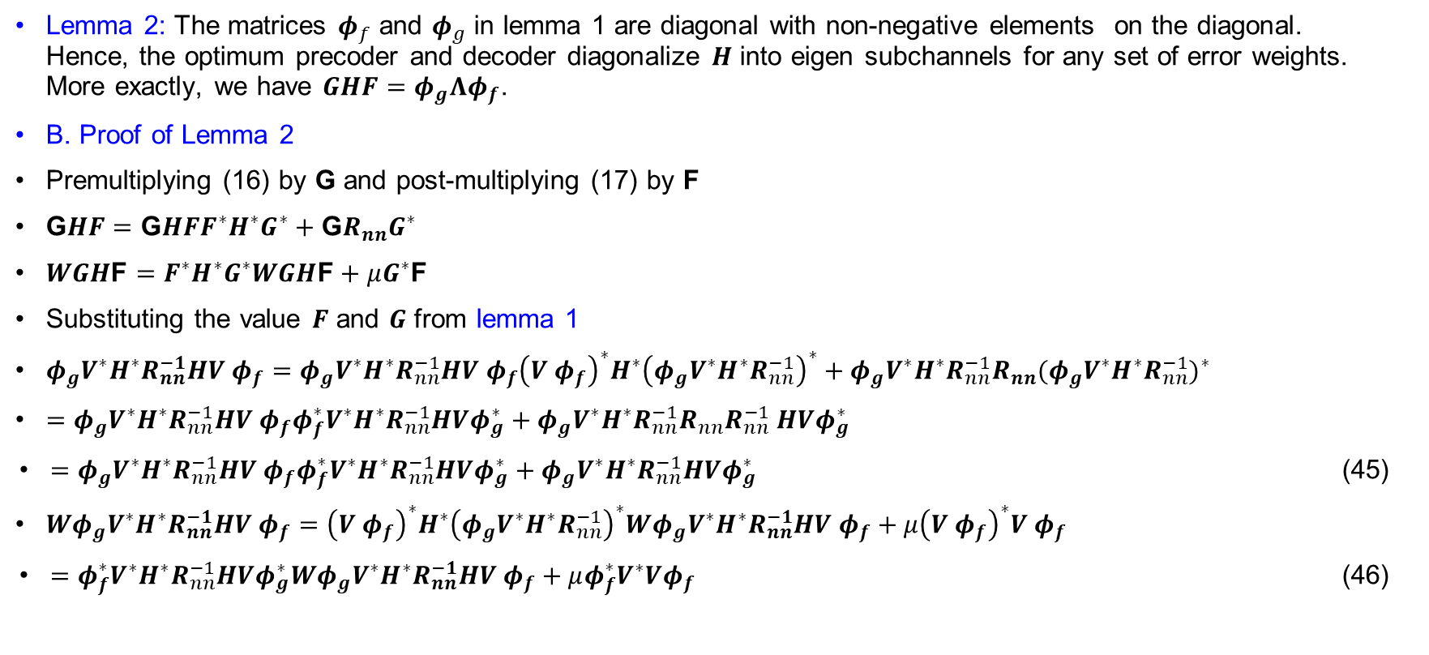
Optimum Precoder and Decoder
Lemma 2: The matrices $φ_{f}$ and $φ_{g}$ in lemma 1 are diagonal with non-negative elements on the diagonal. Hence, the optimum precoder and decoder diagonalize $H$ into eigen subchannels for any set of error weights. More exactly, we have $GHF=φ_{g}Λφ_{f}$.
B. Proof of Lemma 2
Premultiplying (16) by G and post-multiplying (17) by F
$\text{G}HF=\text{G}HFF^{∗}H^{∗}G^{∗}+{\text{G}R}_{nn}G^{∗}$
$WGH\text{F}=F^{∗}H^{∗}G^{∗}WGH\text{F}+μG^{∗}\text{F}$
Substituting the value $F$ and $G$ from lemma 1
$φ_{g}V^{∗}H^{∗}R_{nn}^{−1}HV φ_{f}=φ_{g}V^{∗}H^{∗}R_{nn}^{−1}HV φ_{f}{\left(V φ_{f}\right)}^{∗}H^{∗}{\left(φ_{g}V^{∗}H^{∗}R_{nn}^{−1}\right)}^{∗}+{φ_{g}V^{∗}H^{∗}R_{nn}^{−1}R}_{nn}{{(φ}_{g}V^{∗}H^{∗}R_{nn}^{−1})}^{∗}$
$=φ_{g}V^{∗}H^{∗}R_{nn}^{−1}HV φ_{f}φ_{f}^{∗}V^{∗}H^{∗}R_{nn}^{−1}HVφ_{g}^{∗}+{φ_{g}V^{∗}H^{∗}R_{nn}^{−1}R}_{nn}R_{nn}^{−1} HVφ_{g}^{∗}$
$=φ_{g}V^{∗}H^{∗}R_{nn}^{−1}HV φ_{f}φ_{f}^{∗}V^{∗}H^{∗}R_{nn}^{−1}HVφ_{g}^{∗}+φ_{g}V^{∗}H^{∗}R_{nn}^{−1}HVφ_{g}^{∗}$ (45)
$Wφ_{g}V^{∗}H^{∗}R_{nn}^{−1}HV φ_{f}={\left(V φ_{f}\right)}^{∗}H^{∗}{\left(φ_{g}V^{∗}H^{∗}R_{nn}^{−1}\right)}^{∗}Wφ_{g}V^{∗}H^{∗}R_{nn}^{−1}HV φ_{f}+μ{\left(V φ_{f}\right)}^{∗}V φ_{f}$
$=φ_{f}^{∗}V^{∗}H^{∗}R_{nn}^{−1}HVφ_{g}^{∗}Wφ_{g}V^{∗}H^{∗}R_{nn}^{−1}HV φ_{f}+μφ_{f}^{∗}V^{∗}Vφ_{f}$ (46)

Slide 19
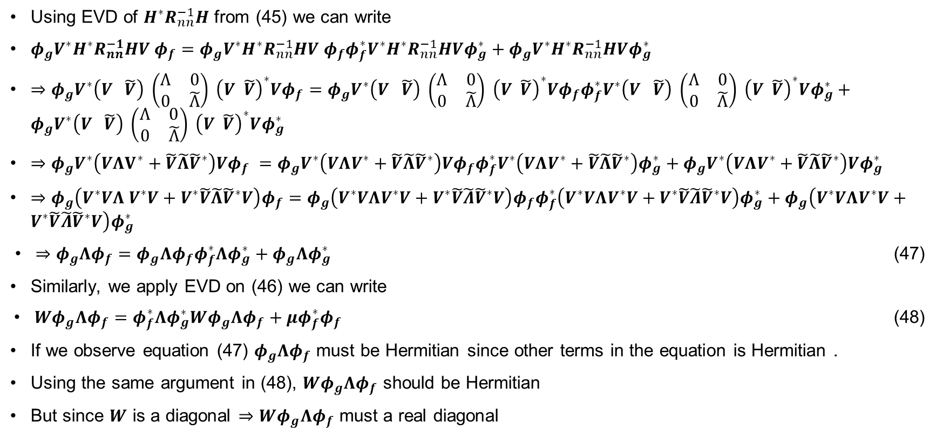
Optimum Precoder and Decoder
Using EVD of $H^{∗}R_{nn}^{−1}H$ from (45) we can write
$φ_{g}V^{∗}H^{∗}R_{nn}^{−1}HV φ_{f}=φ_{g}V^{∗}H^{∗}R_{nn}^{−1}HV φ_{f}φ_{f}^{∗}V^{∗}H^{∗}R_{nn}^{−1}HVφ_{g}^{∗}+φ_{g}V^{∗}H^{∗}R_{nn}^{−1}HVφ_{g}^{∗}$
$⇒φ_{g}V^{∗}\left(V \tilde{V}\right) \left(\begin{matrix}Ʌ & 0 \\ 0 & \tilde{Ʌ}\end{matrix}\right) {\left(V \tilde{V}\right)}^{∗}{Vφ}_{f}=φ_{g}V^{∗}\left(V \tilde{V}\right) \left(\begin{matrix}Ʌ & 0 \\ 0 & \tilde{Ʌ}\end{matrix}\right) {\left(V \tilde{V}\right)}^{∗}Vφ_{f}φ_{f}^{∗}V^{∗}\left(V \tilde{V}\right) \left(\begin{matrix}Ʌ & 0 \\ 0 & \tilde{Ʌ}\end{matrix}\right) {\left(V \tilde{V}\right)}^{∗}Vφ_{g}^{∗}+φ_{g}V^{∗}\left(V \tilde{V}\right) \left(\begin{matrix}Ʌ & 0 \\ 0 & \tilde{Ʌ}\end{matrix}\right) {\left(V \tilde{V}\right)}^{∗}Vφ_{g}^{∗}$
$⇒φ_{g}V^{∗}\left(VΛV^{∗}+\tilde{V}\tilde{Λ}{\tilde{V}}^{∗}\right)Vφ_{f} =φ_{g}V^{∗}\left(VΛV^{∗}+\tilde{V}\tilde{Λ}{\tilde{V}}^{∗}\right)Vφ_{f}φ_{f}^{∗}V^{∗}\left(VΛV^{∗}+\tilde{V}\tilde{Λ}{\tilde{V}}^{∗}\right)φ_{g}^{∗}+φ_{g}V^{∗}\left(VΛV^{∗}+\tilde{V}\tilde{Λ}{\tilde{V}}^{∗}\right)Vφ_{g}^{∗}$
$⇒φ_{g}\left(V^{∗}VΛ V^{∗}V+V^{∗}\tilde{V}\tilde{Λ}{\tilde{V}}^{∗}V\right)φ_{f}=φ_{g}\left(V^{∗}VΛV^{∗}V+V^{∗}\tilde{V}\tilde{Λ}{\tilde{V}}^{∗}V\right)φ_{f}φ_{f}^{∗}\left(V^{∗}VΛV^{∗}V+V^{∗}\tilde{V}\tilde{Λ}{\tilde{V}}^{∗}V\right)φ_{g}^{∗}+φ_{g}\left(V^{∗}VΛV^{∗}V+V^{∗}\tilde{V}\tilde{Λ}{\tilde{V}}^{∗}V\right)φ_{g}^{∗}$
$⇒φ_{g}Λφ_{f}=φ_{g}Λφ_{f}φ_{f}^{∗}Λφ_{g}^{∗}+φ_{g}Λφ_{g}^{∗}$ (47)
Similarly, we apply EVD on (46) we can write
$Wφ_{g}Λφ_{f}=φ_{f}^{∗}Λφ_{g}^{∗}Wφ_{g}Λφ_{f}+μφ_{f}^{∗}φ_{f}$ (48)
If we observe equation (47) $φ_{g}Λφ_{f}$ must be Hermitian since other terms in the equation is Hermitian .
Using the same argument in (48), $Wφ_{g}Λφ_{f}$ should be Hermitian
But since $W$ is a diagonal $⇒$ $Wφ_{g}Λφ_{f}$ must a real diagonal

Slide 20
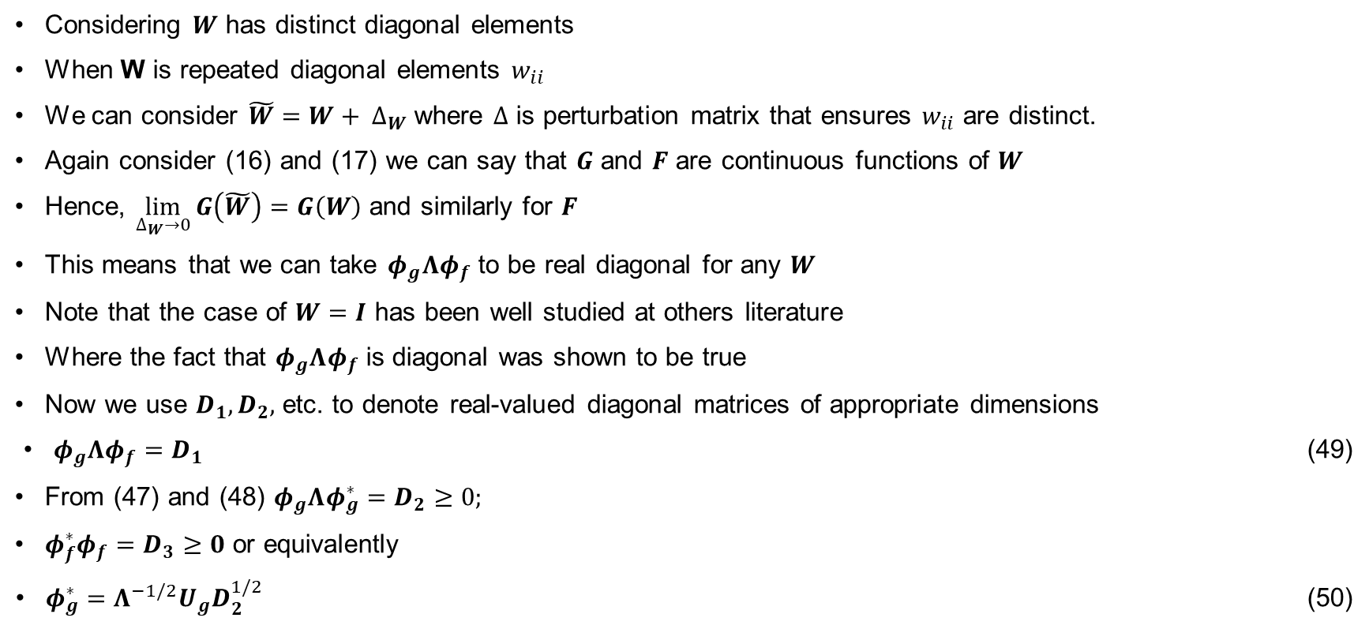
Optimum Precoder and Decoder
Considering $W$ has distinct diagonal elements
When W is repeated diagonal elements $w_{ii}$
We can consider $\tilde{W}=W+ ∆_{W}$ where $∆$ is perturbation matrix that ensures $w_{ii}$ are distinct.
Again consider (16) and (17) we can say that $G$ and $F$ are continuous functions of $W$
Hence, $\lim_{∆_{W}→0}{G\left(\tilde{W}\right)=G\left(W\right)}$ and similarly for $F$
This means that we can take $φ_{g}Λφ_{f}$ to be real diagonal for any $W$
Note that the case of $W=I$ has been well studied at others literature
Where the fact that $φ_{g}Λφ_{f}$ is diagonal was shown to be true
Now we use $D_{1}, D_{2},$ etc. to denote real-valued diagonal matrices of appropriate dimensions
$φ_{g}Λφ_{f}=D_{1}$ (49)
From (47) and (48) $φ_{g}Λφ_{g}^{∗}=D_{2}≥0;$
$φ_{f}^{∗}φ_{f}=D_{3}≥0$ or equivalently
$φ_{g}^{∗}=Λ^{−1/2}U_{g}D_{2}^{1/2}$ (50)

Slide 21
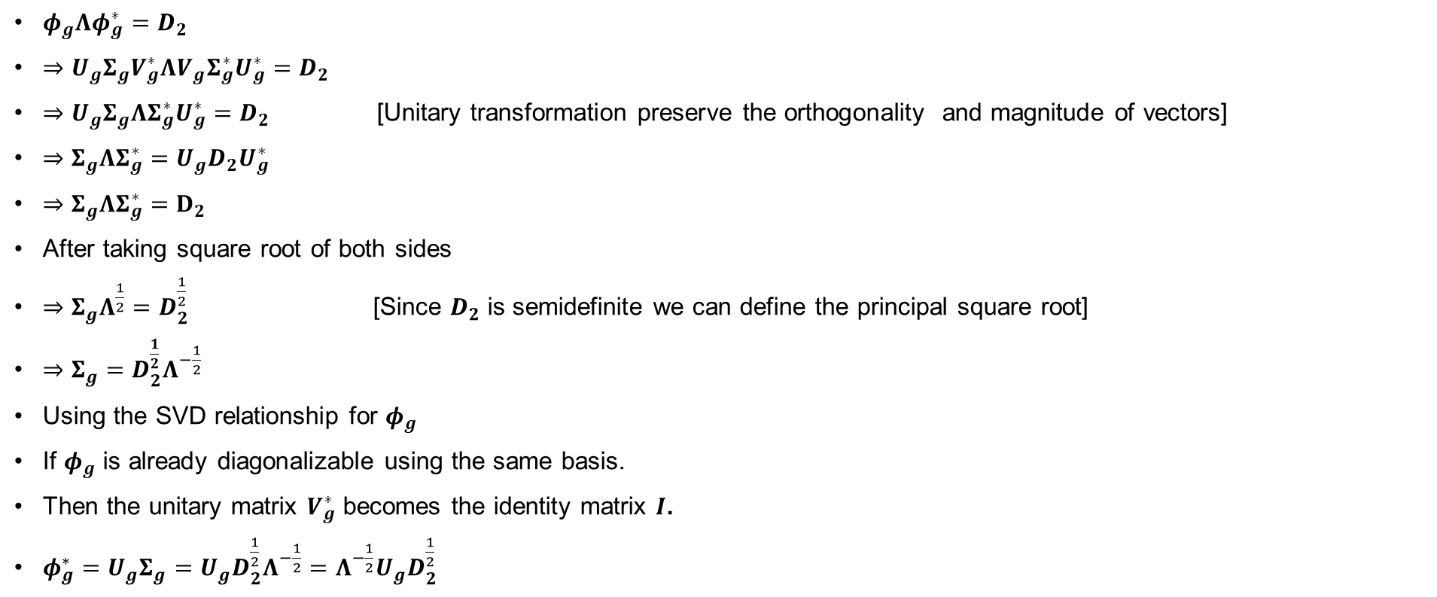
Optimum Precoder and Decoder
$φ_{g}Λφ_{g}^{∗}=D_{2}$
$⇒U_{g}Σ_{g}V_{g}^{∗}ΛV_{g}Σ_{g}^{∗}U_{g}^{∗}=D_{2}$
$⇒U_{g}Σ_{g}ΛΣ_{g}^{∗}U_{g}^{∗}=D_{2}$ [Unitary transformation preserve the orthogonality and magnitude of vectors]
$⇒Σ_{g}ΛΣ_{g}^{∗}=U_{g}D_{2}U_{g}^{∗}$
$⇒Σ_{g}ΛΣ_{g}^{∗}=D_{2}$
After taking square root of both sides
$⇒Σ_{g}Λ^{\frac{1}{2}}=D_{2}^{\frac{1}{2}}$ [Since $D_{2}$ is semidefinite we can define the principal square root]
$⇒Σ_{g}=D_{2}^{\frac{1}{2}}Λ^{−\frac{1}{2}}$
Using the SVD relationship for $φ_{g}$
If $φ_{g}$ is already diagonalizable using the same basis.
Then the unitary matrix $V_{g}^{∗}$ becomes the identity matrix $I$.
$φ_{g}^{∗}=U_{g}Σ_{g}=U_{g}D_{2}^{\frac{1}{2}}Λ^{−\frac{1}{2}}=Λ^{−\frac{1}{2}}U_{g}D_{2}^{\frac{1}{2}}$

Slide 22

Optimum Precoder and Decoder
$φ_{f}^{∗}φ_{f}=D_{3}$
$⇒V_{f}Σ^{∗}U_{f}^{∗}U_{f}ΣV_{f}^{∗}=D_{3}$
$⇒V_{f}Σ^{∗}ΣV_{f}^{∗}=D_{3}$
$⇒Σ_{f}^{∗}Σ_{f}=V_{f}D_{3}V_{f}^{∗}$
Taking square root of both sides
$Σ_{f}^{\frac{1}{2}}=D_{3}^{\frac{1}{2}}$
Using SVD we can write
$φ_{f}=U_{f} Σ_{f}^{\frac{1}{2}}$
$⇒φ_{f}=U_{f}D_{3}^{\frac{1}{2}}$
Inserting equation (50) into (49),
$D_{2}^{\frac{1}{2}}U_{g}^{∗}Λ^{\frac{1}{2}}U_{f}D_{3}^{\frac{1}{2}}=D_{1}$

Slide 23
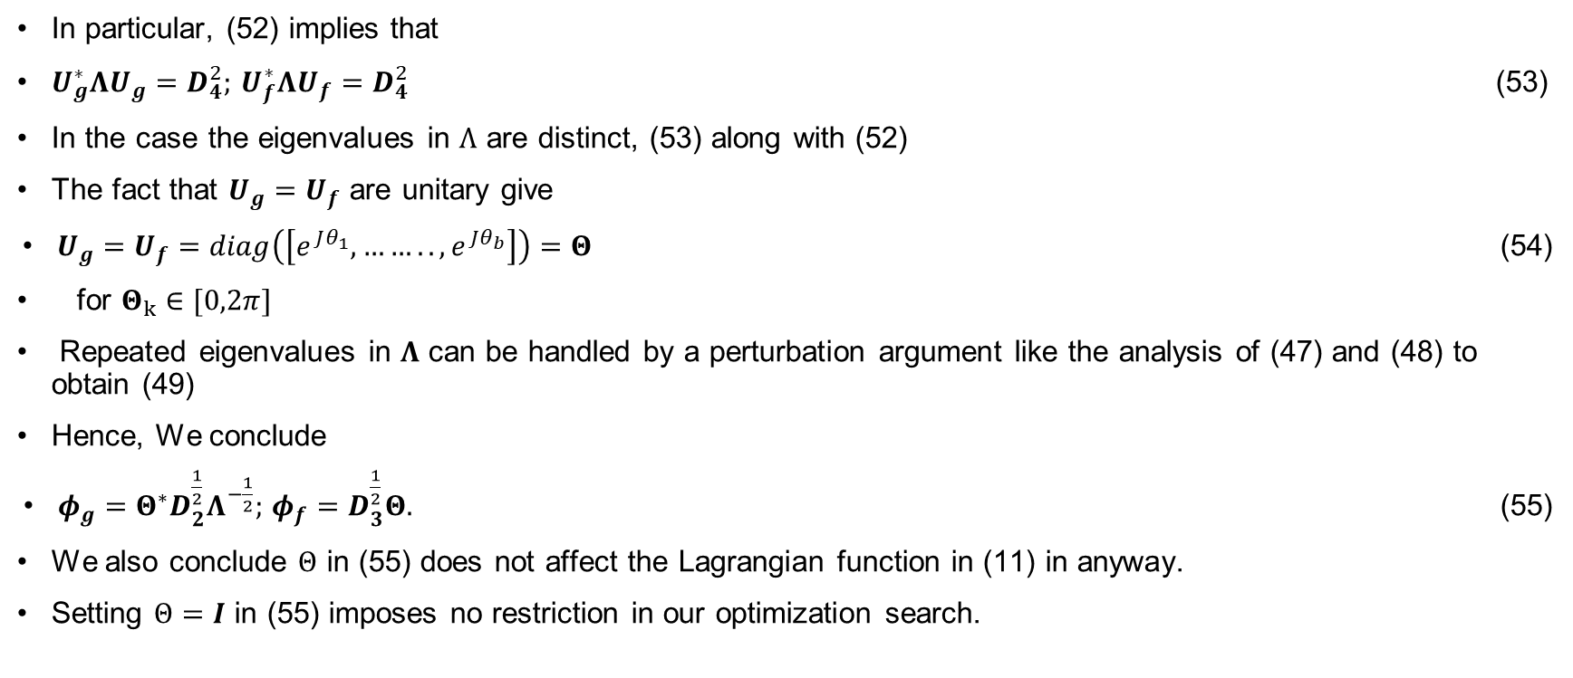
Optimum Precoder and Decoder
In particular, (52) implies that
$U_{g}^{∗}ΛU_{g}=D_{4}^{2};$ $U_{f}^{∗}ΛU_{f}=D_{4}^{2}$ (53)
In the case the eigenvalues in $Λ$ are distinct, (53) along with (52)
The fact that $U_{g}=U_{f}$ are unitary give
$U_{g}=U_{f}=diag\left(\left[e^{Jθ_{1}},…….., e^{Jθ_{b}}\right]\right)=Θ$ (54)
for $Θ_{k}∈[0,2π]$
Repeated eigenvalues in $Λ$ can be handled by a perturbation argument like the analysis of (47) and (48) to obtain (49)
Hence, We conclude
$φ_{g}=Θ^{∗}D_{2}^{\frac{1}{2}}Λ^{−\frac{1}{2}};$ $φ_{f}=D_{3}^{\frac{1}{2}}Θ.$ (55)
We also conclude $Θ$ in (55) does not affect the Lagrangian function in (11) in anyway.
Setting $Θ=I$ in (55) imposes no restriction in our optimization search.

Slide 24
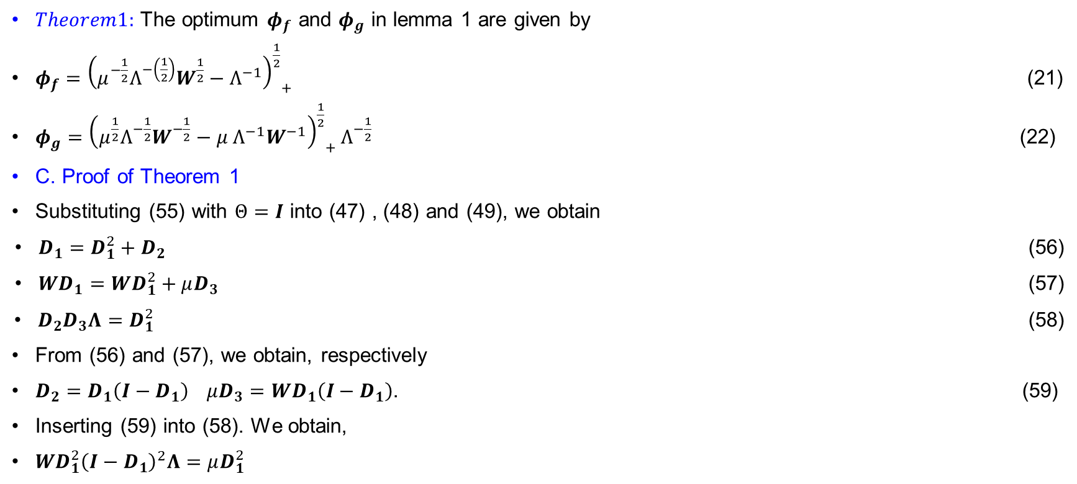
Optimum Precoder and Decoder
$Theorem1:$ The optimum $φ_{f}$ and $φ_{g}$ in lemma 1 are given by
$φ_{f}={{\left(μ^{−\frac{1}{2}}Ʌ^{−\left(\frac{1}{2}\right)}W^{\frac{1}{2}}−Ʌ^{−1}\right)}^{\frac{1}{2}}}_{+}$ (21)
$φ_{g}={{\left(μ^{\frac{1}{2}}Ʌ^{−\frac{1}{2}}W^{−\frac{1}{2}}−μ Ʌ^{−1}W^{−1}\right)}^{\frac{1}{2}}}_{+}Ʌ^{−\frac{1}{2}}$ (22)
C. Proof of Theorem 1
Substituting (55) with $Θ=I$ into (47) , (48) and (49), we obtain
$D_{1}=D_{1}^{2}+D_{2}$ (56)
$WD_{1}=WD_{1}^{2}+μD_{3}$ (57)
$D_{2}D_{3}Λ=D_{1}^{2}$ (58)
From (56) and (57), we obtain, respectively
$D_{2}=D_{1}\left(I−D_{1}\right)$ $μD_{3}=WD_{1}\left(I−D_{1}\right)$. (59)
Inserting (59) into (58). We obtain,
$WD_{1}^{2}{\left(I−D_{1}\right)}^{2}Λ=μD_{1}^{2}$

Slide 25

Optimum Precoder and Decoder
The solution assuming $D_{1}>0$
$D_{1}={\left(I −μ^{\frac{1}{2}}Λ^{−\frac{1}{2}}W^{−\frac{1}{2}}\right)}_{+}$ (60)
Using (60) in (59) for $μ>0,$
$D_{2}={\left(μ^{\frac{1}{2}}Λ^{−\frac{1}{2}}W^{−\frac{1}{2}}−μΛ^{−1}W^{−1}\right)}_{+}$
And $D_{3}=W{\left(μ^{−\frac{1}{2}}Λ^{−\frac{1}{2}}W^{−\frac{1}{2}}−Λ^{−1}W^{−1}\right)}_{+}$
The above expression for $D_{2}$ and $D_{3}$ along with (55) lead to (22) and (21), which concludes the proof for $D_{1}>0.$

Slide 26
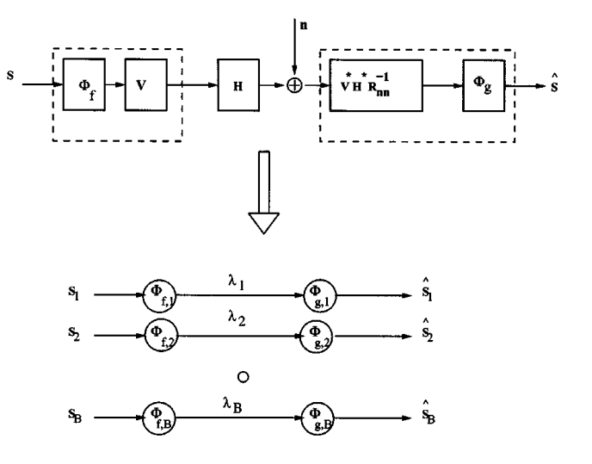
Optimum Precoder and Decoder
Fig. 3. Optimum Precoder and Decoder into eigen subchannels

Slide 27
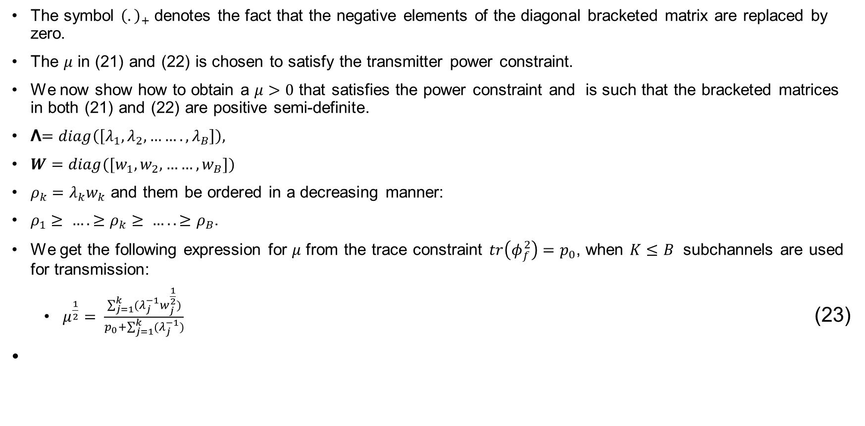
Optimum Precoder and Decoder
The symbol ${\left(.\right)}_{+}$ denotes the fact that the negative elements of the diagonal bracketed matrix are replaced by zero.
The $μ$ in (21) and (22) is chosen to satisfy the transmitter power constraint.
We now show how to obtain a $μ>0$ that satisfies the power constraint and is such that the bracketed matrices in both (21) and (22) are positive semi-definite.
Ʌ$=diag\left(\left[λ_{1}, λ_{2},……., λ_{B}\right]\right),$
$W=diag([w_{1},w_{2},……,w_{B}])$
$ρ_{k}=λ_{k}w_{k}$ and them be ordered in a decreasing manner:
$ρ_{1}≥ …. ≥ρ_{k}≥ ….. ≥ρ_{B}$.
We get the following expression for $μ$ from the trace constraint $tr\left(φ_{f}^{2}\right)=p_{0}$, when $K≤B$ subchannels are used for transmission:
$μ^{\frac{1}{2}}= \frac{\sum_{j=1}^{k}{(λ_{j}^{−1}w_{j}^{\frac{1}{2}})}}{p_{0}+\sum_{j=1}^{k}{(λ_{j}^{−1})}}$ (23)

Slide 28
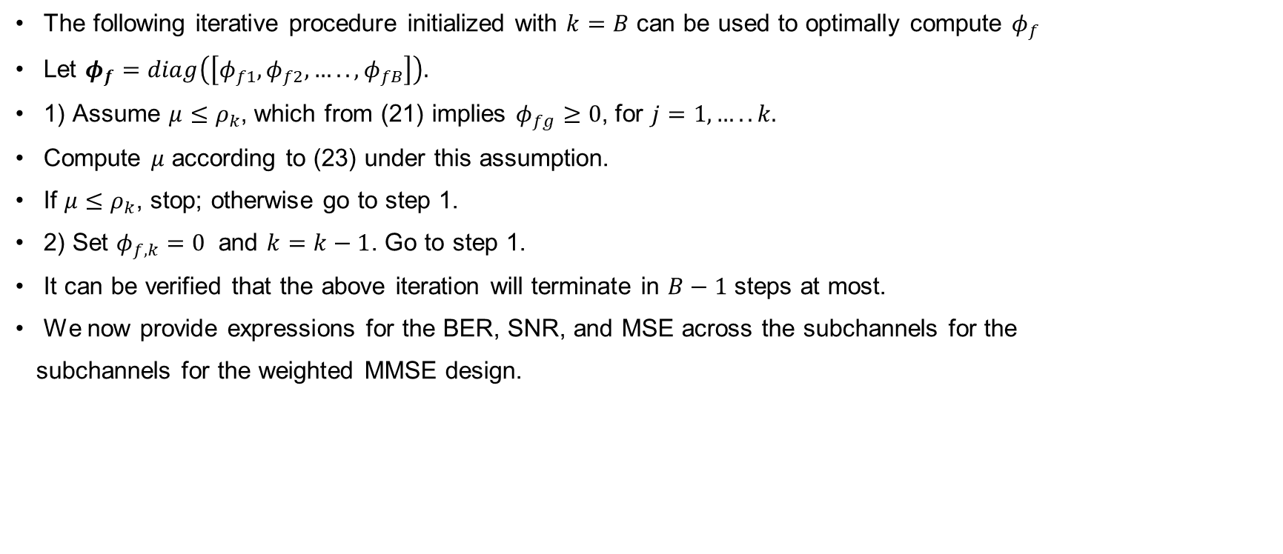
Optimum Precoder and Decoder
The following iterative procedure initialized with $k=B$ can be used to optimally compute $φ_{f}$
Let $φ_{f}=diag\left(\left[φ_{f1},φ_{f2},…..,φ_{fB}\right]\right).$
1) Assume $μ≤ρ_{k}$, which from (21) implies $φ_{fg}≥0$, for $j=1,…..k.$
Compute $μ$ according to (23) under this assumption.
If $μ≤ρ_{k}$, stop; otherwise go to step 1.
2) Set $φ_{f,k}=0$ and $k=k−1$. Go to step 1.
It can be verified that the above iteration will terminate in $B−1$ steps at most.
We now provide expressions for the BER, SNR, and MSE across the subchannels for the
subchannels for the weighted MMSE design.

Slide 29
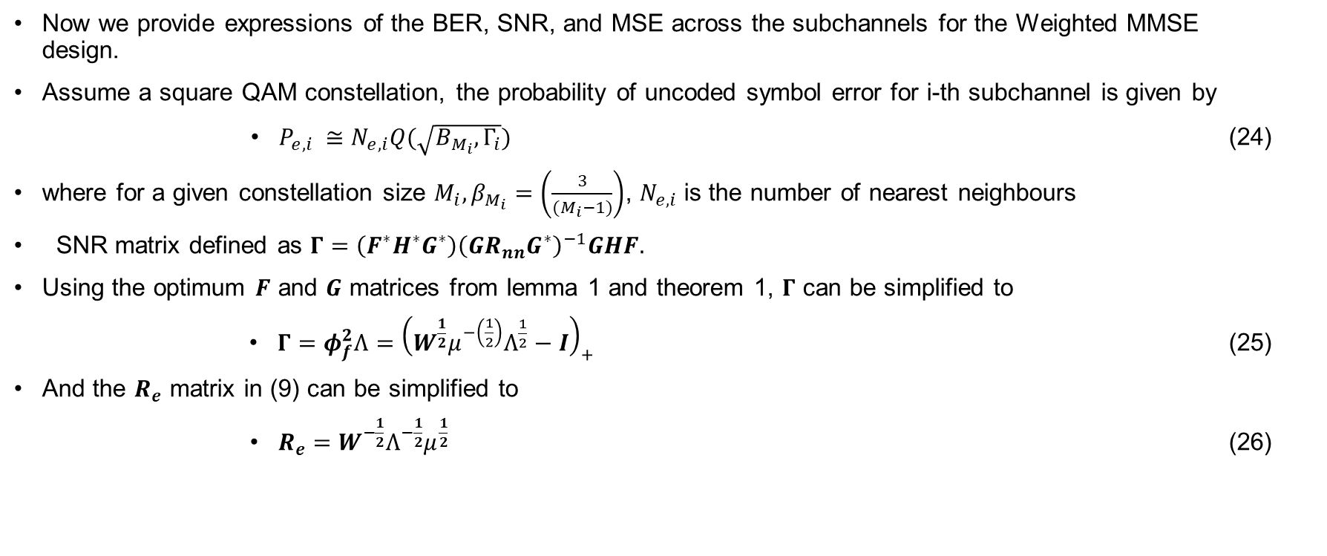
Optimum Precoder and Decoder
Now we provide expressions of the BER, SNR, and MSE across the subchannels for the Weighted MMSE design.
Assume a square QAM constellation, the probability of uncoded symbol error for i-th subchannel is given by
$P_{e,i} ≅N_{e,i}Q(\sqrt{B_{M_{i}},Γ_{i}})$ (24)
where for a given constellation size $M_{i},β_{M_{i}}=\left(\frac{3}{{(M}_{i}−1)}\right)$, $N_{e,i}$ is the number of nearest neighbours
SNR matrix defined as $Γ=\left(F^{∗}H^{∗}G^{∗}\right){\left(GR_{nn}G^{∗}\right)}^{−1}GHF.$
Using the optimum $F$ and $G$ matrices from lemma 1 and theorem 1, $Γ$ can be simplified to
$Γ=φ_{f}^{2}Ʌ={\left(W^{\frac{1}{2}}μ^{−\left(\frac{1}{2}\right)}Ʌ^{\frac{1}{2}}−I\right)}_{+}$ (25)
And the $R_{e}$ matrix in (9) can be simplified to
$R_{e}=W^{−\frac{1}{2}}Ʌ^{−\frac{1}{2}}μ^{\frac{1}{2}}$ (26)

